Slide 1
COVID-19 and the Liver
Presented by Derek Scholes
Review paper written by Dinesh Jothimani, Radhika Venugopal, Mohammed Forhad Abedin, Ilankumaran Kaliamoorthy, Mohamed Rela

Slide 2
Overview
Introduction
Epidemiology
ACE2 Receptors
Transmission
COVID-19 and hepatic dysfunction
COVID-19 and liver histology
Clinical Outcome of COVID-19

Slide 3
Overview (cont.)
Diagnosis
Management
COVID-19 and HCC
COVID-19 and deceased donor transplantation
Post-liver transplant COVID-19
Conclusion

Slide 4
Introduction
80% homology between SARS-CoV and the current novel coronavirus
60% of patients during previous SARS epidemic developed various degrees of liver damage
Due to phylogenetic resemblance, there is a possibility that SARS-CoV-2 also causes liver injury

Slide 5
Epidemiology
December 2019: A few unexplained cases of pneumonia in Wuhan, China
January 3, 2020: SARS-CoV-2 found in an index case via bronchoalveolar lavage
WHO subsequently declared an epidemic
March 11, 2020: WHO declared a pandemic due to the rapid rise in infections

Slide 6
Epidemiology (cont.)
Initial epicenter in Wuhan
The first 41 cases of severe pneumonia reported in Wuhan after exposure to bats and pangolins
Later incidents were not exposed to these animals suggesting person to person transmission
May 19, 2020: 4,731,458 cases worldwide
Doubling rate of 7.2 days

Slide 7
ACE2 Receptors
Similar to SARS-CoV, the susceptible receptor for SARS-CoV-2 appears to be Angiotensin-converting enzyme 2 (ACE2)
In vitro studies during the SARS pandemic showed that ACE2 is present in type 2 alveolar cells, the gastrointestinal tract and the liver
ACE2 expressed at 59.7% in cholangiocytes and 2.6% in hepatocytes
A study from Wuhan indicated that Asian men have higher expression of ACE2. Possible increased susceptibility

Slide 8
Transmission
Initially a zoonotic infection
Spreads rapidly via droplets
Remains viable 2 hours to 14 days depending on fomite and conditions
Faeco-oral transmission (Day 5, 80% of patients COVID+ with anal swabs and sheds in stool even after negative oral swab)
WHO prevention guidelines should be used to prevent transmission (wash hands 20 sec, social distancing, 60% alcohol rub, avoid social gatherings.

Slide 9
Clinical Features
Incubation period of 3-7 days, possibly up to 14
Symptoms:
Fever
Dry Cough
Fatigue
Myalgia
Leukopenia
Raised liver enzymes
In 2-10% of patients
Nausea
Vomiting
Diarrhea

Slide 10
Clinical Features (cont.)
Other Clinical Features
54-58% males
Prolonged prothrombin time
Raised lactate dehydrogenase
Acute Respiratory Distress Syndrome (ARDS)
Symptoms to ARDS ~8 days
Bilateral Pneumonia
Increased AST and hypersensitive cardiac troponin
Higher white blood cell count and severe progressive lymphopenia in non-survivors
Progressive deterioration in renal function before death

Slide 11
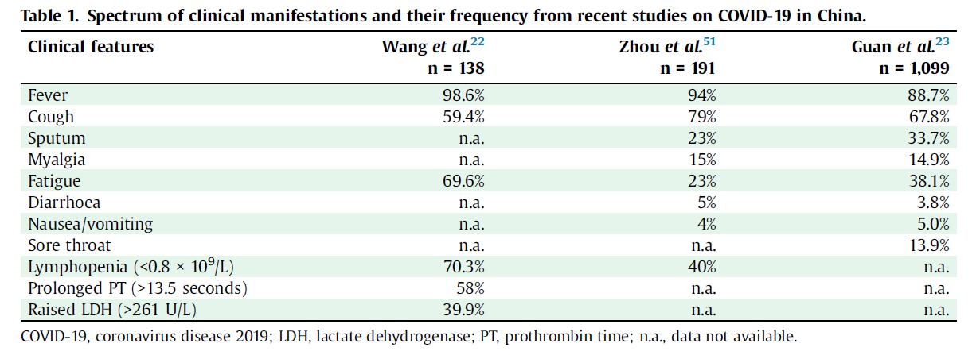
Clinical Features (cont.)

Slide 12
COVID-19 and Hepatic Dysfunction
Liver is a potential target of COVID-19 due to high expression of ACE2 in cholangiocytes
May worsen underlying chronic liver disease leading to hepatic decompensation and acute-on-chronic liver failure
2-11% of patients with COVID-19 are reported to have underlying chronic liver disease
14-53% developed some form of hepatic dysfunction
Increased gamma glutamyltransferase (GGT) in severe cases

Slide 13
COVID-19 and Hepatic Dysfunction (cont.)
Dysfunction higher in critically ill patients
Raised AST in critically ill patients (62% compared to 25%)
Peak ALT and AST were noted as 7,590 U/L and 1,445 U/L respectively
Higher liver enzymes noted when patients received lopinavir/ritonavir therapy (56.1% vs. 25%)
Unsure if this was drug induced liver damage or disease per se
Liver injury could be caused by cytokine storm in severe cases instead of directly by the virus

Slide 14
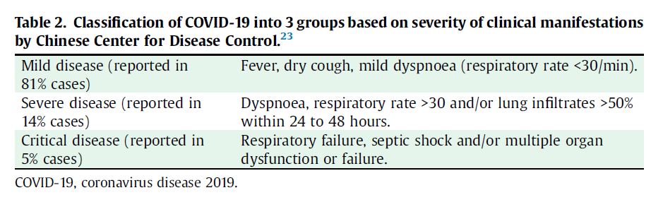
COVID-19 and Hepatic Dysfunction (cont.)

Slide 15

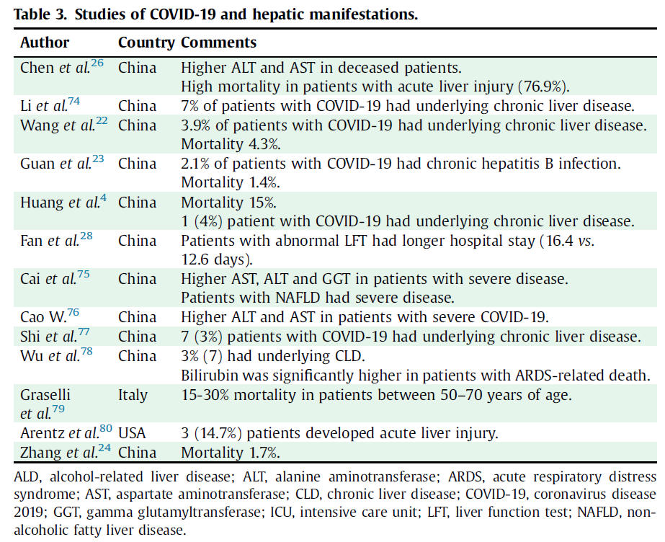

COVID-19 and Hepatic Dysfunction (cont.)

Slide 16
COVID-19 and Liver Histology
Severe COVID-19 cases may cause (post-mortem findings)
Moderate microvesicular steatosis
Mild inflammatory infiltrates in the hepatic lobule and portal tract
Unknown if caused by the viral infection or drugs
Reduced but hyperactive CD4 and CD8 cells in proinflammatory state w/ increased CCR6+ Th17 CD4 T cells and cytotoxicity granulations in CD8 cells
Other study: Mild sinusoidal dilations and focal microvesicular steatosis
SARS CoV-2 RNA isolated in liver tissue

Slide 17
COVID-19 and Liver Histology (cont.)
COVID-19 possibly causes a cell cycle arrest following infection causing a higher Ki-67 than present in Hepatitis C and liver regeneration (evidence of increased proliferative state)?
SARS: 50% of patients with SARS developed abnormal liver function tests, most recovered. Those with severe disease and high ALT predicted ICU admission and death. SARS possibly caused it rather than solely associated
MERS: utilization of dipeptidyl peptidase 4 which is abundant in the liver. Low albumin was found as predictor for severe cases. Liver injury in non-survivors vs. survivors (91.3% vs 77.9%)

Slide 18
Clinical Outcome of COVID-19
Increasing respiratory distress leading to pneumonia
19.6% of severe cases of COVID-19 developed ARDS
16.7% of severe cases of COVID-19 developed myocarditis
8.7% of severe cases developed septic shock
These numbers increased if admitted to the ICU to 61%, 44.4%, and 30.6% respectively
Mortality was higher in men and those >75 yrs and co-morbidities

Slide 19
Clinical Outcome of COVID-19 (cont.)
Comorbidities in deceased patients
Hypertension, cardiac disease, diabetes, chronic respiratory illness, chronic kidney disease
Common characteristics in deceased patients
Increased AST (53%>16%), ALT (27%>19%), alkaline phosphate (65%>14%), GGT, and bilirubin
5% of patients with COVID-19 developed acute liver injury and 76.9% of them died

Slide 20
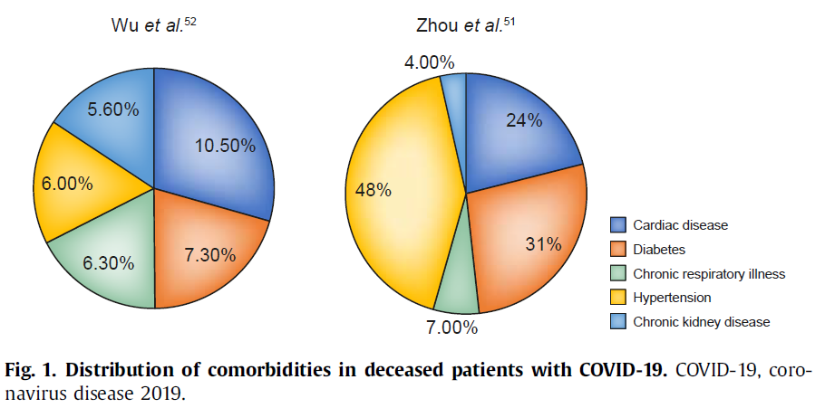
Clinical Outcome of COVID-19 (cont.)

Slide 21
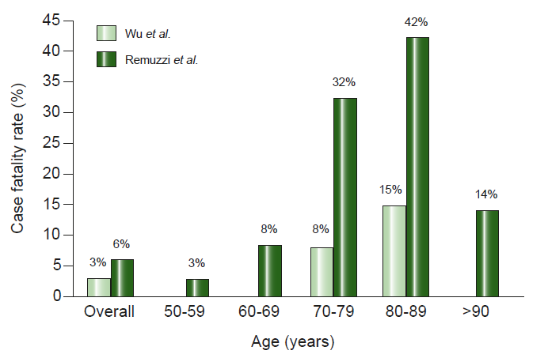
Clinical Outcome of COVID-19 (cont.)

Slide 22
Diagnosis
Diagnosis of COVID-19 based on Real time reverse transcription polymerase chain reaction (RT-PCR)
Viral RNA extracted and open reading frame amiplified
Swabs used include: throat, oral, nasal and rectal
SARS Cov-2 continues to be shed in stool even after negative respiratory sample

Slide 23
Management
Current Treatment
Antiviral drugs
Antibiotics (secondary infection)
Intravenous fluids
Corticosteroids (reduce inflammation/reduced mortality)
HBsAg-positive patients should receive antiviral therapy
Other disproven treatments
Oseltamivir
Remdisivir
Ribavirin
Lopinavir/ritonavir

Slide 24
COVID-19 and HCC
Higher risk of contracting SARS CoV-2
Those with HCC are at higher risk for worse outcomes due to the cancer and liver dysfunction
HCC treatment should be postponed two months in the case of COVID-19

Slide 25
COVID-19 and Deceased Donor Transplantation
Significant decline in organ donations due to COVID 19
Increases the waiting list for liver and other solid organ transplants
Risk of disease transmission to the transplant team
This may be an interesting topic to pursue when the vaccination is available

Slide 26
Post-liver Transplant COVID-19
Those who are post liver transplant are not at higher risk of mortality for SARS-CoV and MERS-CoV
Immunosuppressive medication is to be continued, and some evidence is show to help inhibit SARS-CoV at higher doses
Drug interactions should be monitored in post-liver transplant patients due to a possible drug toxicity via enzyme inhibition

Slide 27
Conclusion
A pandemic with a mortality rate of 2-6%
Increases with age and comorbidities
COVID-19 causes pneumonia
Hepatic dysfunction occurs in severe cases and is associated with a fatal outcome such as with severe acute liver injury
Long-term follow-up is needed to verify the extent and cause of liver damage
Further research needed for detailed evaluation

